Slide 1
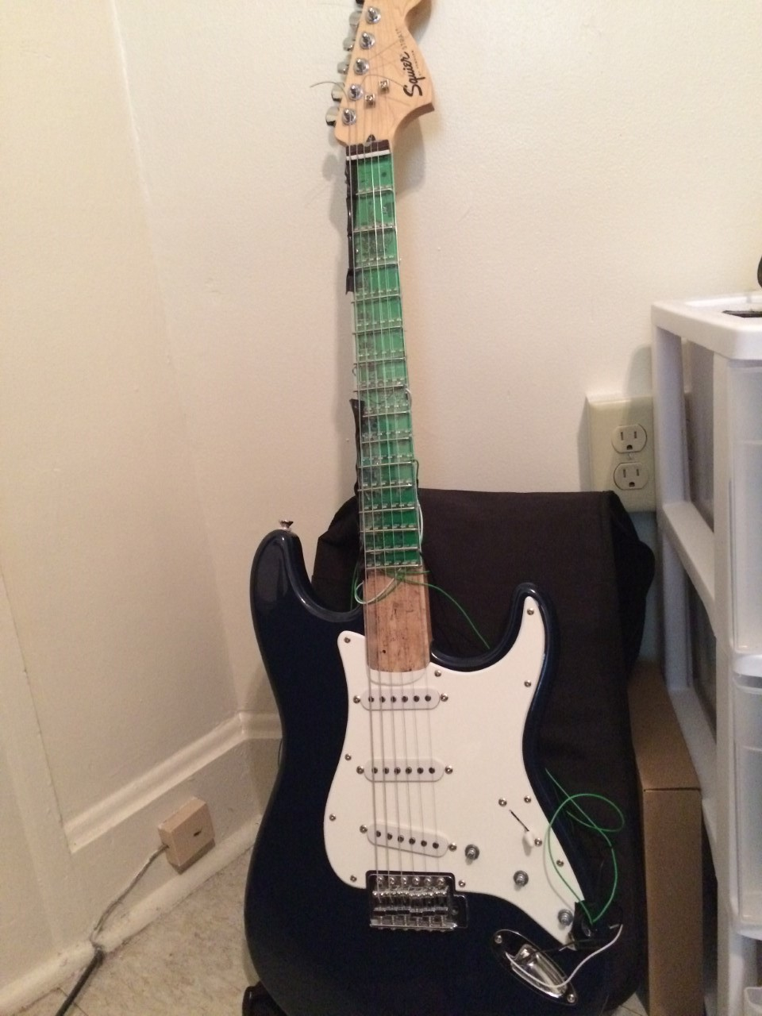
ECE 477 Final Review: Team #12
<Add team picture or relevant project picture here>

Slide 2
Outline
Project Overview
Block Diagram
Design Challenges
Individual Contributions
Project Demonstration
Questions

Slide 3
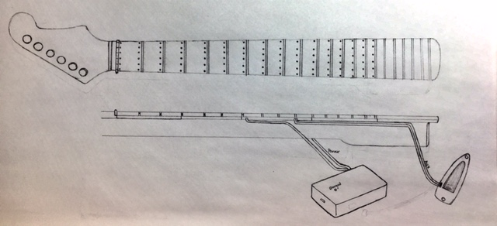
Project Overview
Guitutar is an LED embedded guitar neck that is designed to serve as a supplement to learning how to play the guitar. Once attached, Guitutar will allow for two modes of operation: learning mode and full playback. Learning mode would wait for the user to press the correct notes/chord and wait for a strum. A switch matrix using the guitar’s strings and frets serves as the chord/note detection while an amplifier circuit connects to the guitar’s pickup and serves as the method of strum detection. Full playback mode will play the full song and light up the chords and notes at the right time.

Slide 4
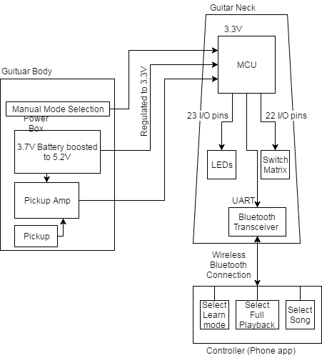
Block Diagram

Slide 5
Design Challenges
Connecting multiple PCBs with solder bridges
PCB layout (traces and multiple layers)
PCB size restricted to guitar neck size
Common grounds
Debugging
Harmony vs PLIB.h
Programming post packaging
Bluetooth transceiver (designed using BM78 and not with RN4020)
Final packaging of guitar neck
Final packaging of power box

Slide 6
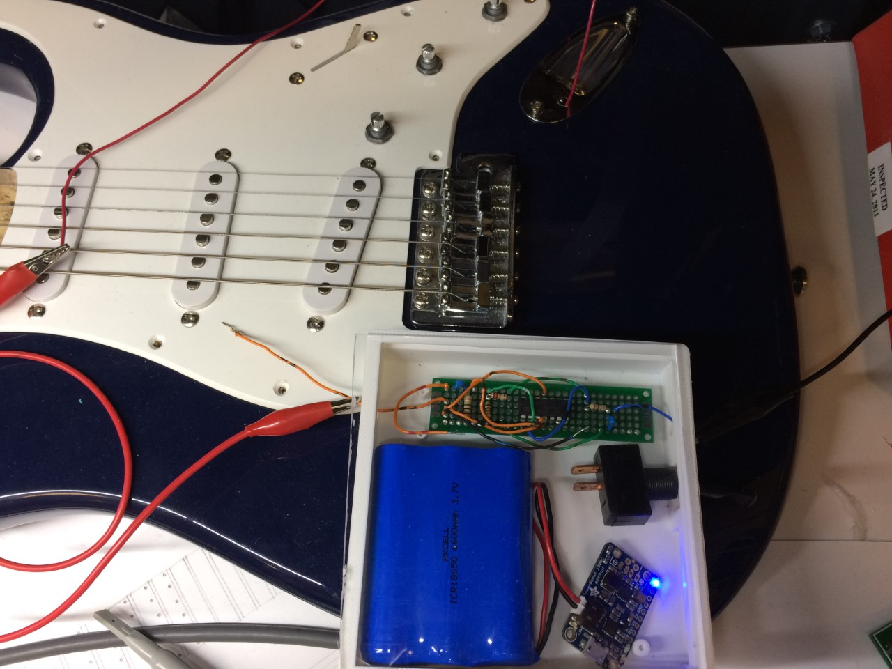
Individual contributions
Austin Peterson
Schematic/PCB Design
Power considerations
Pickup amplifier
Testing components before final design
Packaging design and build for Power Box and Guitar Neck
PCB soldering
Hardware debugging
Part selection and purchasing
Guitar sacrifice
Notes:
For each member of your team, detail his/her individual contributions to the project. Each student should be prepared to speak for ~1 minute regarding their contributions to the project.

Slide 7
Individual contributions
Brian rieder
Contributed to the general planning process
Served as the resident guitar “expert”
Helped with generalized engineering group decisions
Configured the software development environment to allow for device programming
Wrote software to implement:
LED driving via GPIO
Song encoding - turning an LED array into a software accessible interface
String-fret switch matrix - translating human finger position into played notes
Multi-mode configuration and final implementation mode switching

Slide 8
Individual contributions
Jennifer isaza
Schematic/PCB Design
Fretboard Design
PCB soldering
Acrylic Fretboard Overlay
Testing components before final design
PCB soldering
Hardware debugging
Part selection and purchasing
PCB soldering

Slide 9
Individual contributions
Cole giannotti
Designed data encoding structures for song information
Birthed delay concept and implementation
Wrote Android phone application to interface with guitar
Wrote software to implement:
Song encoding / decoding
String-fret switch matrix - translating human finger position into played notes
Multi-mode configuration and final implementation mode switching
Fretboard data structure to quickly add notes and push out information to the display

Slide 10
Project Demonstration
…
PSSC #1: An ability to interact with the system through an external user interface such as a phone or remote.
PSSC #2: An ability to interface the microcontroller with an external device via Bluetooth.
PSSC #3: An ability to recognize and process pitches played by a user through a sensing interface.
PSSC #4: An ability to display chords and notes on an LED array on the guitar neck.
PSSC #5: An ability to have the microcontroller support two modes for user learning and full playback.
Notes:
List your PSSCs in the space below, but do not read them during the presentation. Provide a link to a demonstration video of your project in action on your team website (720p 16:9 HD is recommended).

Slide 11
Questions?

